Slide 1


To-Do List App
Project Overview
Welcome to the JDBC major project focused on streamlining task management. With a key feature of adding priority to each task, this project aims to enhance task organization and productivity.
by Mohanty Hitesh And Syed Sadiqu Hussain
Under the Supervision of Prof. Er. P.R. Mohapatra

Slide 2
Abstract:
The proposed application offers a user-friendly interface that facilitates seamless task organization and prioritization. Users can assign priority levels to each task, ranging from high to low, enabling them to focus their efforts on the most crucial responsibilities first. Additionally, the application provides customization options, allowing users to categorize tasks by project, deadline, or any other relevant criteria, further enhancing their ability to manage complex workflows.
Key features of the To-Do list application include intuitive task creation, priority allocation functionalities to ensure users stay informed of impending deadlines and high-priority tasks. Moreover, ensuring optimal usability and effectiveness in assisting users with task prioritization and management.
By leveraging technology to streamline task management processes, the proposed To-Do list application aims to empower individuals with the tools they need to navigate their busy lives with clarity, efficiency, and peace of mind.

Slide 3
Problem Statement
The project aims to enhance task management using JDBC, with a focus on adding priority to tasks for efficient organization and execution.
Lack of Prioritization: Existing to-do list applications often lack the functionality to assign priority levels to tasks, resulting in an inability for users to distinguish between urgent and less critical tasks.
Overwhelming Task Management: Without a clear system for prioritization, users may feel overwhelmed by the sheer volume of tasks on their to-do lists, leading to decreased productivity and increased stress levels.
Inefficient Time Management: Without a means to prioritize tasks, individuals may spend excessive time on low-priority tasks, neglecting more important responsibilities and jeopardizing overall productivity.

Slide 4

Literature Review
Improving Time Management Through Modern-Day To-Do Lists [SARINA SCHRAGER, MD, MS info, Fam Pract Manag. 2022]
“It's not enough to be busy; so are the ants. The question is, what are we busy about?” — Henry David Thoreau
Taking an idea and putting it down on paper (or in a digital notes app) has been shown to decrease anxiety, and
completing a task and crossing it off the list provides a sense of tangible satisfaction..
The to-do list also provides a structure from which to plan and organize.
Java JDBC CRUD : SQL Insert, Select, Update, and Delete [Written by Nam Ha Minh, Last Updated on 02 September 2019]
These CRUD operations are equivalent to the INSERT, SELECT, UPDATE and DELETE statements in SQL language. Although the target database system is MySQL, but the same technique can be applied for other database systems as well because the query syntax used is standard SQL which is supported by all relational database systems.

Slide 5

Main Feature: Priority Addition
Enhanced Task Organization
Improved Productivity
Adding priority will facilitate clear task management, allowing users to focus on crucial tasks.
Priority assignment will contribute to better time management and efficient task execution.

Slide 6
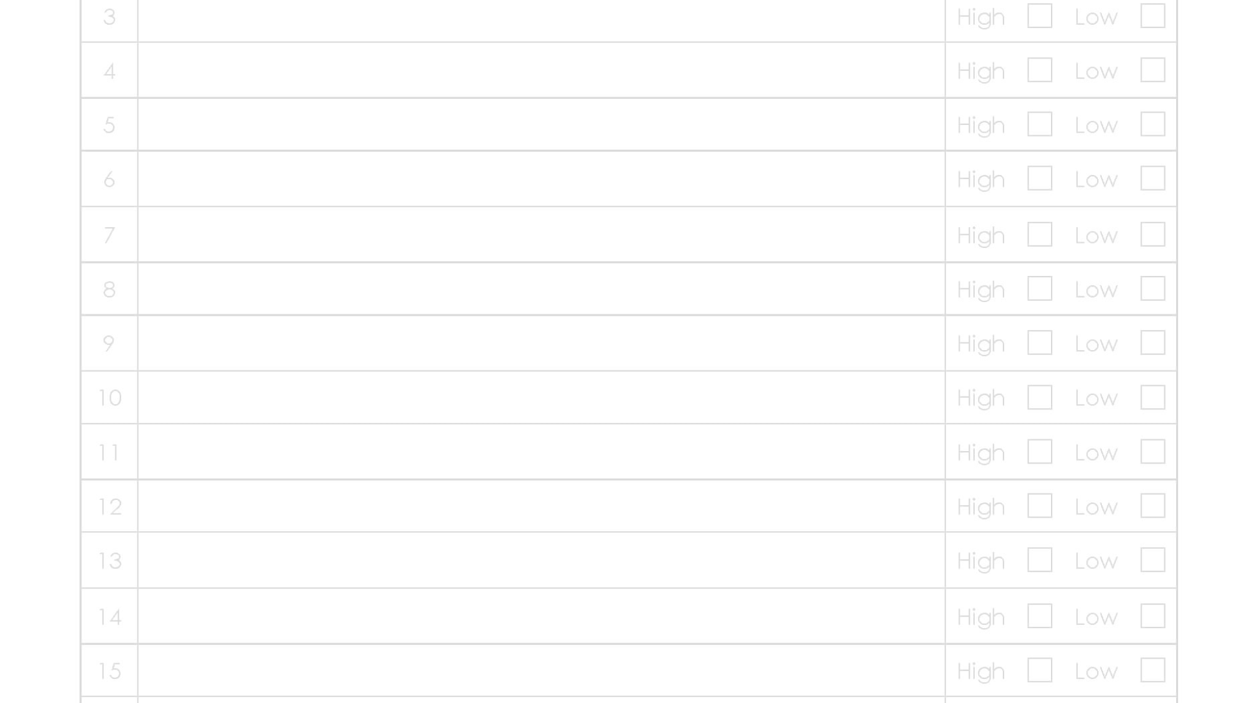



Task Retrieval & Display
Retrieval
Filtering
Display
Retrieve all tasks from the database.
Filter tasks based on priority levels.
Present tasks in order of priority for easy identification.

Slide 7
Adding Priority
User Input
Validation
Provide a user-friendly interface to assign priority levels to new tasks.
Ensure data integrity by validating priority inputs against predefined criteria.

Slide 8
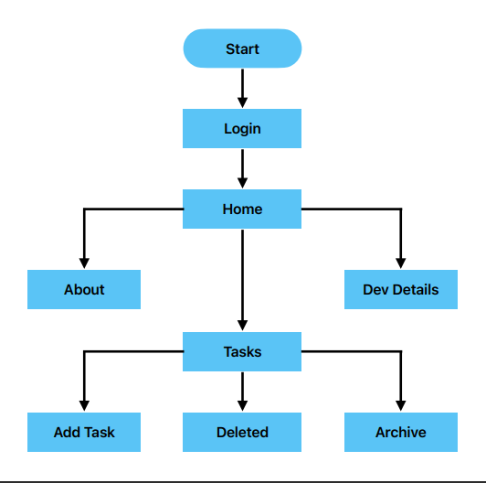
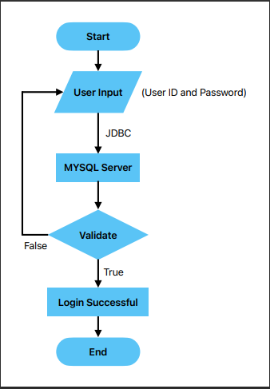
User Login Flow
JDBC Program Flow

Slide 9




Updating Task Priority
User Action
Allow users to update priority levels of existing tasks as per changing requirements.
Database Update
Ensure seamless reflection of updated priority in the database.
Notification
Notify users of successful priority updates for effective task tracking.

Slide 10

Conclusion & Next Steps
1
Implementation
2
Testing & Feedback
3
Future Enhancements
Proceed with implementing priority addition feature based on the project roadmap.
Conduct comprehensive testing and gather user feedback for further refinements.
Explore advanced features to augment task prioritization for an enhanced user experience.

Slide 11
References
Schrager, S. (2022, January 15). Improving Time Management Through Modern-Day To-Do Lists. AAFP. https://www.aafp.org/pubs/fpm/issues/2022/0100/p5.html
Sawhney, V. (2023, July 27). Why We Continue to Rely on (and Love) To-Do Lists.
Harvard Business Review.
https://hbr.org/2022/01/why-we-continue-to-rely-on-and-love-to-do-lists
Minh, N. H. (n.d.). Java JDBC CRUD Tutorial: SQL Insert, Select, Update, and Delete Examples.
https://www.codejava.net/java-se/jdbc/jdbc-tutorial-sql-insert-select-update-and-
delete-examples

Slide 12
Thank you
Any Questions?

